Slide 1
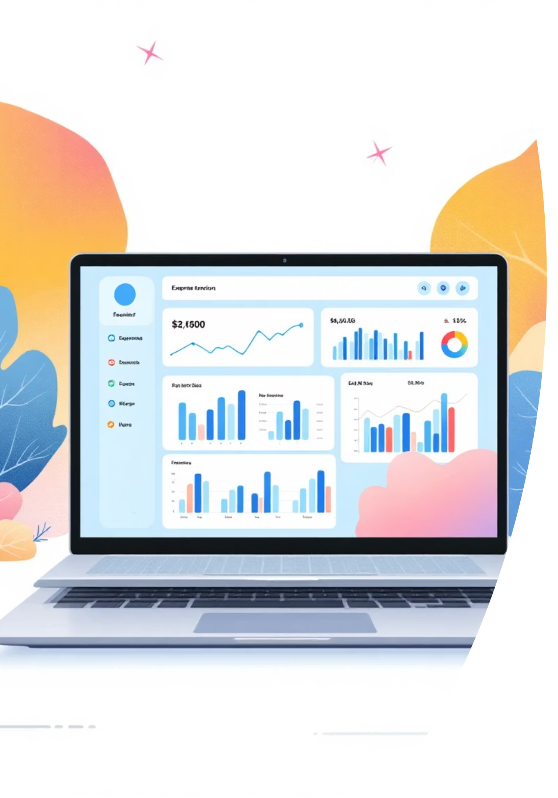
Expense Tracker Application
A full-stack web application designed to help users record, categorize, analyze, and visualize personal expenses securely using Spring Boot backend and modern JavaScript frontend.

Slide 2





Project Goals & Objectives
Secure Authentication
Expense Management
JWT-based user registration and login with role-based access control
Add, update, and delete expenses with category organization
Visual Insights
Scalable Architecture
Interactive charts and dashboards for financial analysis
Production-ready deployment with secure data handling

Slide 3

Key Features Implemented
Authentication & Security
Analytics & Visualization
User registration and login
Total expenses summary
JWT-based authentication
Category-wise distribution
Role-based API access
Monthly expense trends
Secure REST endpoints
Pie, bar, and line charts
Expense Management
Deployment
Add, edit, and delete expenses
Backend on Render
Category-wise organization
PostgreSQL cloud database
Detailed expense tracking
Secure environment variables

Slide 4





System Architecture
Frontend
HTML, CSS, JavaScript, Bootstrap for user interface
Backend
Spring Boot, Spring Security for business logic
Authentication
JWT for secure access control
Database
MySQL/PostgreSQL for persistent storage
Deployment
Render for cloud hosting

Slide 5
Application Flow
01
02
03
User Registration
User Login
Dashboard Access
Create account with credentials securely stored in database
JWT token generated and stored in browser localStorage
Token validated on each API request, user redirected to dashboard
04
05
Expense Operations
Analytics & Visualization
Add, edit, delete categories and expenses stored in PostgreSQL
Backend sends data via REST APIs, frontend renders charts with Chart.js

Slide 6
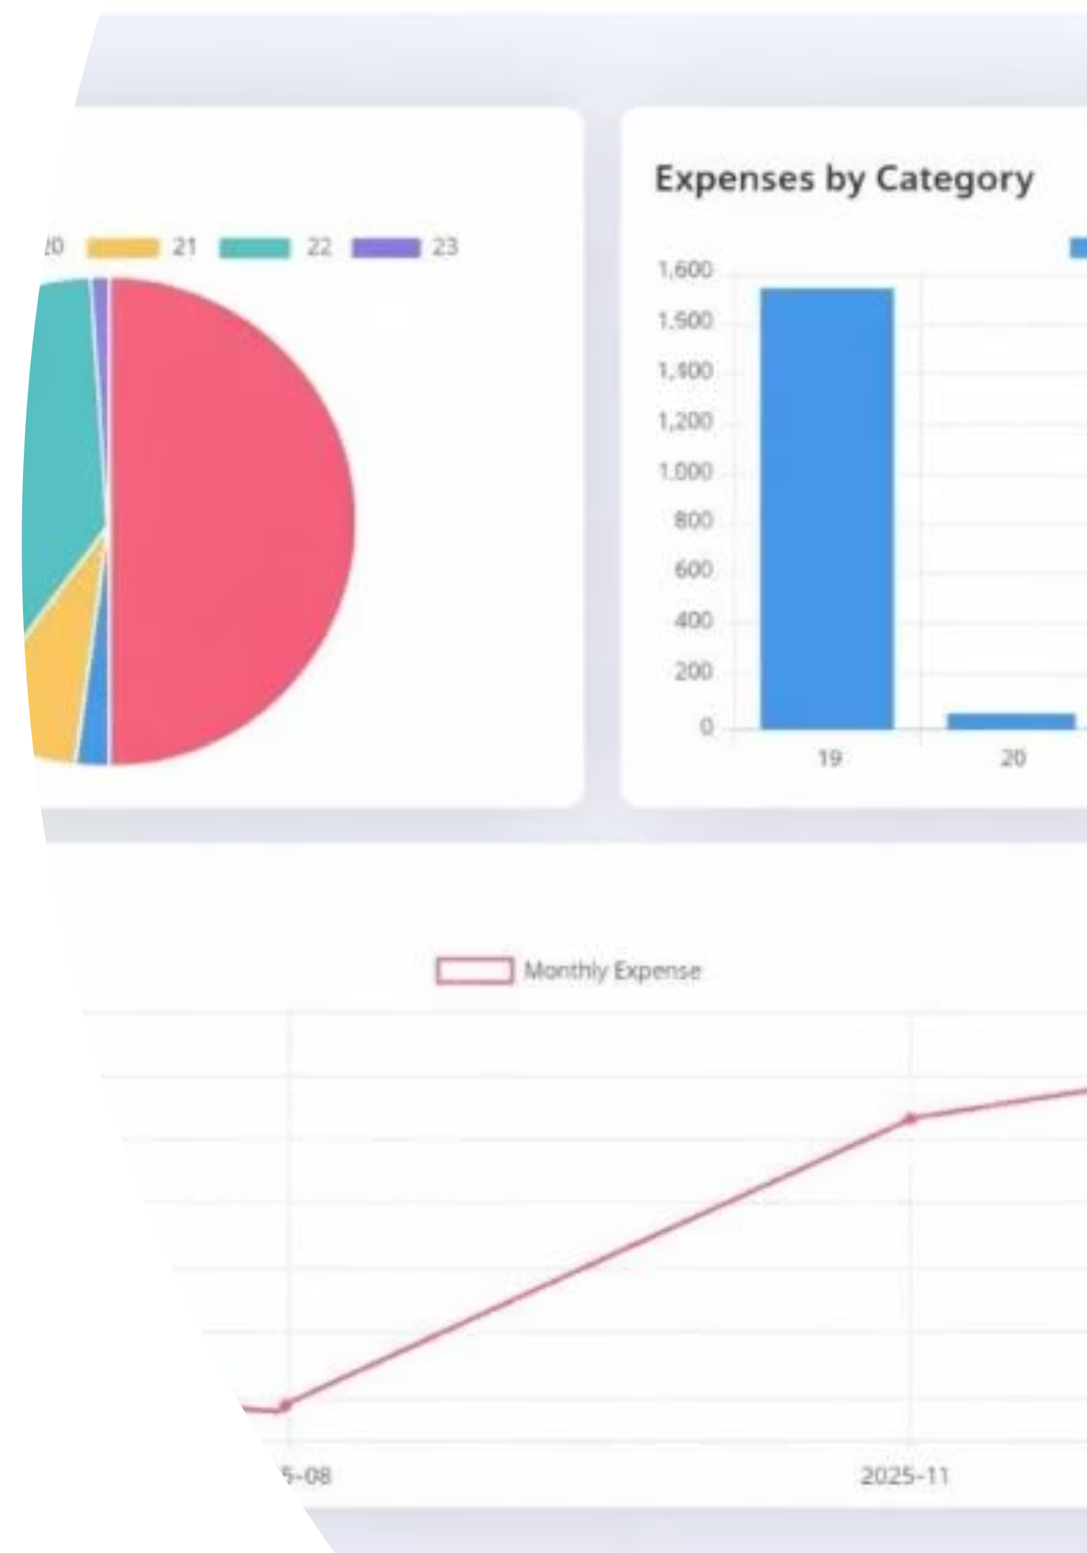
Dashboard Insights
₹3110
5
6
Total Expenses
Total Categories
Total Entries
Comprehensive spending overview
Organized expense tracking
Detailed transaction records
The dashboard provides pie charts for expense distribution, bar charts for category analysis, and line charts for monthly trends—helping users understand spending patterns.

Slide 7
REST API Design
Authentication APIs
Category APIs
Expense APIs
POST /api/v1/auth/register
GET /api/v1/category
GET /api/v1/expenses
POST /api/v1/auth/login
POST /api/v1/category
POST /api/v1/expenses
PUT /api/v1/category/{id}
PUT /api/v1/expenses/{id}
DELETE /api/v1/category/{id}
DELETE /api/v1/expenses/{id}

Slide 8

Security Considerations
JWT-Based Authentication
Secure token-based access control for all API requests
Environment Variables
Database secrets and credentials protected through configuration
Spring Security Protection
Backend API endpoints secured with role-based access
Least Privilege Principle
Users granted only necessary permissions for operations

Slide 9
Future Enhancements
Advanced Filters
Export Reports
Dark Mode UI
AI Categorization
Monthly and yearly expense filtering
CSV and Excel report generation
Enhanced user experience with theme options
Intelligent expense classification
Real-Time Notifications
Microservices
Instant expense alerts and reminders
Cloud-native scalable architecture

Slide 10




Learning Outcomes & Conclusion
Full Stack Development
REST API Design
Java, Spring Boot, Spring Security mastery
JWT authentication and secure endpoints
Cloud Deployment
Database Integration
Production-ready hosting on Render
PostgreSQL cloud deployment
The Expense Tracker Application is a production-ready full-stack project that showcases practical skills for Java Full Stack Developer roles. It combines secure backend development, interactive frontend design, and cloud deployment—making it a strong portfolio project.

